Slide 1
WPF Advanced
C# WPF Tips

Slide 2
C# WPF Tips 목차
WPF Chart
Live Chart (Win Form)
Live Chart (WPF)
DevExpress

Slide 3
WPF Chart
InteractiveDataDisplay.WPF
NuGet 패키지에서 ‘InteractiveDataDisplay’로 검색 후 ‘avostres.InteractiveDataDisplay.WPF’ 설치
xmlns:d3="clr-namespace:InteractiveDataDisplay.WPF;assembly=InteractiveDataDisplay.WPF"
...
<d3:Chart BottomTitle="Argument" LeftTitle="Function">
<d3:LineGraph x:Name="linegraph" Description="Simple linegraph" Stroke="Blue" StrokeThickness="3"/>
</d3:Chart>

Slide 4
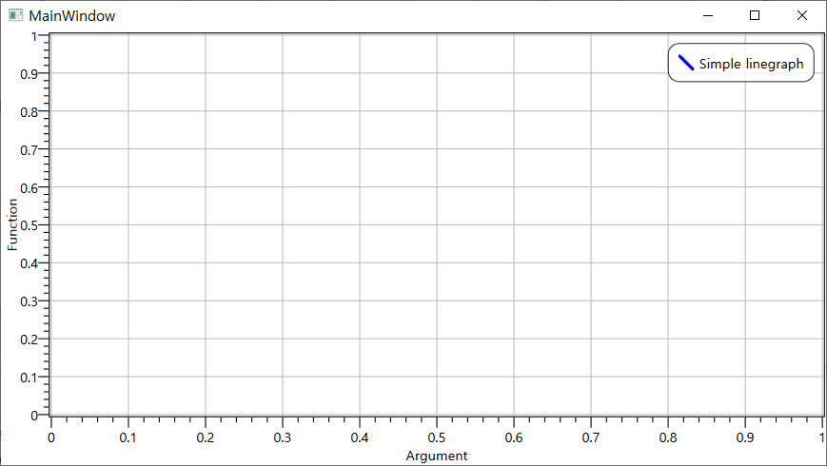
WPF Chart
InteractiveDataDisplay.WPF
실행 결과

Slide 5
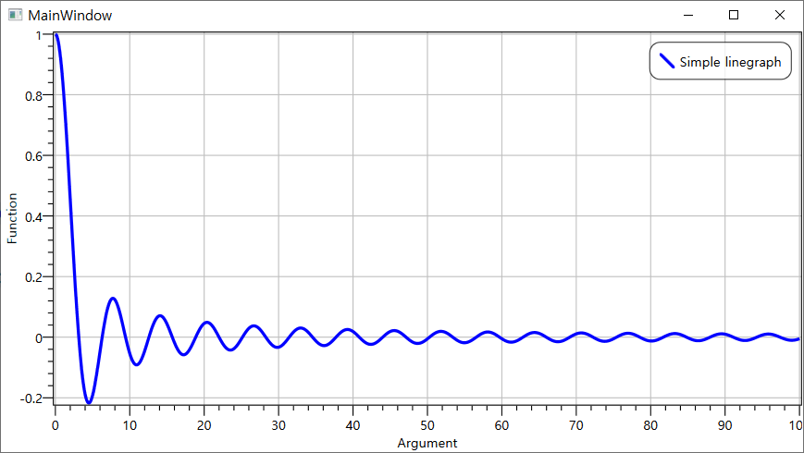
WPF Chart
InteractiveDataDisplay.WPF
추가 수정
private void Window_Loaded(object sender, RoutedEventArgs e)
{
var x = Enumerable.Range(0, 1001).Select(i => i / 10.0).ToArray();
var y = x.Select(v => Math.Abs(v) < 1e-10 ? 1 : Math.Sin(v) / v).ToArray();
linegraph.Plot(x, y);
}

Slide 6
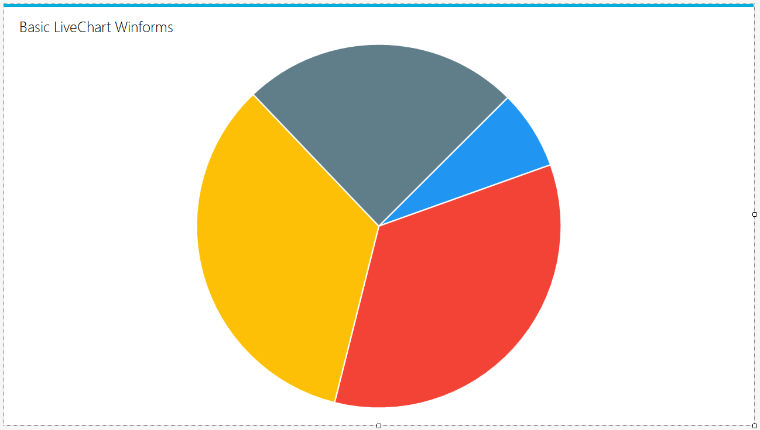
Live Chart (Winform)
Tutorial
프로젝트 생성 후 NuGet패키지 관리
LiveCharts.Winforms 설치
도구상자에서 드래그

Slide 7
Live Chart (Winform)
Tutorial
Form_Load 메서드
Func<ChartPoint, string> labelPoint = chartPoint => string.Format("{0} ({1:P})", chartPoint.Y, chartPoint.Participation);
// 차트에 표시 할 항목 모음 정의
SeriesCollection piechartData = new SeriesCollection {
new PieSeries {
Title = "First Item",
Values = new ChartValues<double> {25},
DataLabels = true,
LabelPoint = labelPoint
},
new PieSeries {
Title = "Second Item",
Values = new ChartValues<double> {25},
DataLabels = true,
LabelPoint = labelPoint
},
new PieSeries {
Title = "Third Item",
Values = new ChartValues<double> {25},
DataLabels = true,
LabelPoint = labelPoint
}
};

Slide 8
Live Chart (Winform)
Tutorial
Form_Load 메서드
// 컬렉션의 add 메서드를 사용하여 새 항목을 동적으로 추가
// 정적이 아닌 데이터를 동적으로 정의 할 때 유용
piechartData.Add(
new PieSeries
{
Title = "Fourth Item",
Values = new ChartValues<double> { 25 },
DataLabels = true,
LabelPoint = labelPoint,
Fill = System.Windows.Media.Brushes.Gray
}
);
// 파이차트에 표시 할 값 모음 정의
pieChart1.Series = piechartData;
// 범례 위치를 차트 오른쪽에 표시하도록 설정
pieChart1.LegendLocation = LegendLocation.Right;

Slide 9
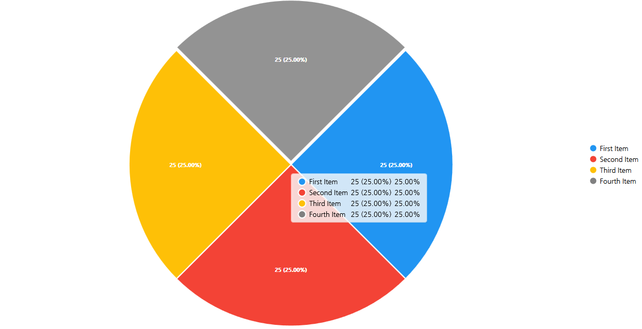
Live Chart (Winform)
Tutorial
실행결과

Slide 10
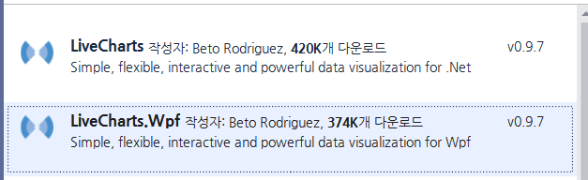
Live Chart (WPF)
Tutorial
프로젝트 생성 후 NuGet패키지 관리
LiveCharts.Wpf 설치
네임스페이스 추가
xmlns:lvc="clr-namespace:LiveCharts.Wpf;assembly=LiveCharts.Wpf"
or
using LiveCharts;
using LiveCharts.Wpf;

Slide 11
Live Chart (WPF)
Tutorial
Xaml에 추가
xmlns:lvc="clr-namespace:LiveCharts.Wpf;assembly=LiveCharts.Wpf"
or
using LiveCharts;
using LiveCharts.Wpf;

Slide 12
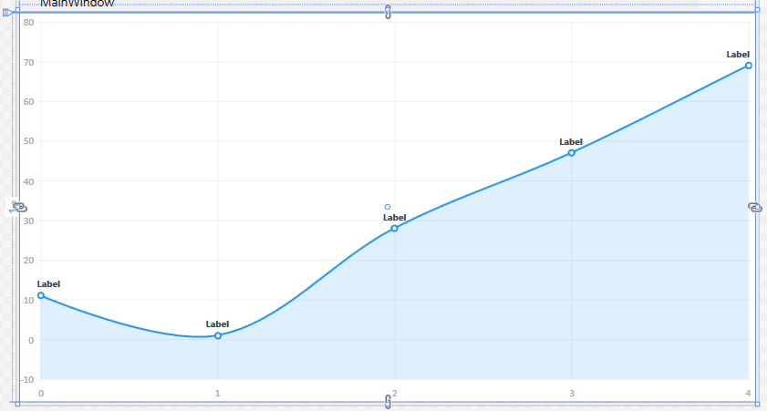
Live Chart (WPF)
Tutorial
Xaml 파일 수정
<lvc:CartesianChart Grid.Row="2">
<lvc:CartesianChart.Series>
<lvc:LineSeries Values="{Binding Values}" DataLabels="True" />
</lvc:CartesianChart.Series>
<lvc:CartesianChart.DataTooltip>
<!--The Selection mode property should be done automatically in future versions-->
<lvc:DefaultTooltip SelectionMode="SharedYValues"></lvc:DefaultTooltip>
</lvc:CartesianChart.DataTooltip>
</lvc:CartesianChart>

Slide 13
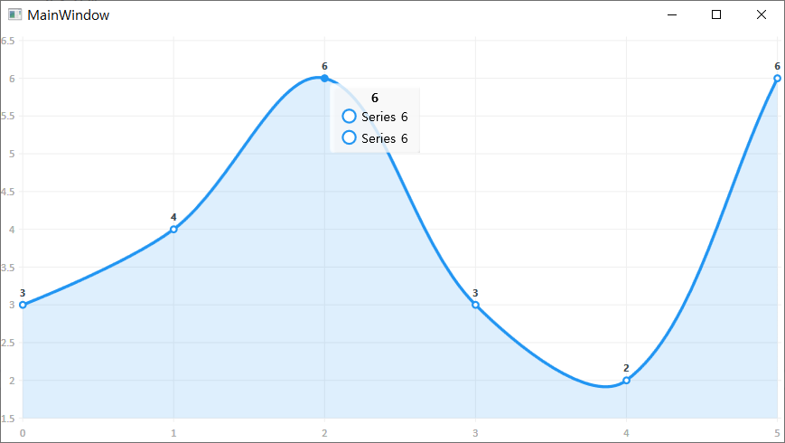
Live Chart (WPF)
Tutorial
cs 파일 수정
실행 결과
public ChartValues<float> Values { get; set; }
private void InitChart()
{
Values = new ChartValues<float> { 3, 4, 6, 3, 2, 6 };
DataContext = this;
}

Slide 14
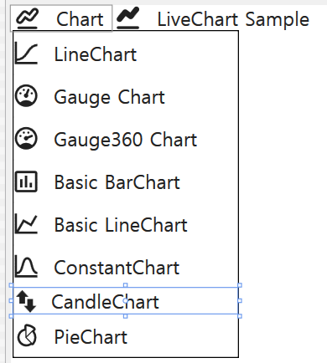
Live Chart (WPF)
Tutorial MVVM
프로젝트 생성
Caliburn.Micro, LiveCharts, MahApps.Metro, MahApps.Metro.IconPacks 설치
MVVM 기본 작업
Models, ViewModels, Views 폴더 생성
Bootstrapper 클래스 → 생성자, override OnStartup
App.xaml Bootstrapper 리소스 및 MahApps.Metro 리소스 딕셔너리 xaml 파일 구성
ViewModels > ShellViewModel 클래스 작성 → Conductor<object> 클래스 상속
Views > ShellView.xaml 로 변경
xmlns:mah=“http://metro.mahapps.com/winfx/xaml/controls”
xmlns:iconPacks="http://metro.mahapps.com/winfx/xaml/iconpacks"
<mah:MetroWindow …
MenuItem 추가 및
<ContentControl x:Name=“ActiveItem” /> 추가

Slide 15
Live Chart (WPF)
Tutorial MVVM
LineChart 추가
LineChartView.xaml 유저컨트롤
public void LoadLineChart()
{
ActivateItem(new LineChartViewModel());
}
<lvc:CartesianChart Grid.Row="2">
<lvc:CartesianChart.Series>
<lvc:LineSeries Values="{Binding Values}" DataLabels="True" />
</lvc:CartesianChart.Series>
<lvc:CartesianChart.DataTooltip>
<lvc:DefaultTooltip SelectionMode="SharedYValues" />
</lvc:CartesianChart.DataTooltip>
</lvc:CartesianChart>

Slide 16
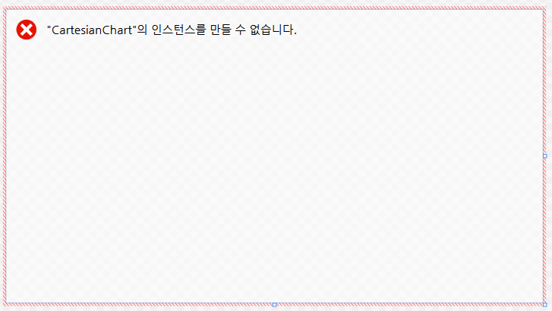
Live Chart (WPF)
Tutorial MVVM
LineChart 추가 문제
아래의 오류가 발생하면 VS 재시작해야 할 것
이전 튜토리얼에 있는 소스를 VIewModel에 이전

Slide 17
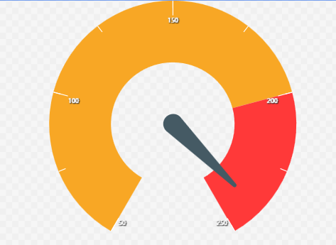
Live Chart (WPF)
Tutorial MVVM
GaugeChartViewModel 생성
GaugeChartView.xaml 생성
public void LoadGaugeChart()
{
ActivateItem(new GaugeChartViewModel());
}
<lvc:AngularGauge
Grid.Row="1" Value="{Binding Value}" FromValue="50" ToValue="250"
LabelsStep="50" TicksStep="25" Wedge="300"
TicksForeground="White" Foreground="White"
FontWeight="Bold" FontSize="16"
SectionsInnerRadius=".5">
<lvc:AngularGauge.Sections>
<lvc:AngularSection FromValue="50" ToValue="200" Fill="#F8A725"/>
<lvc:AngularSection FromValue="200" ToValue="250" Fill="#FF3939"/>
</lvc:AngularGauge.Sections>
</lvc:AngularGauge>

Slide 18
Live Chart (WPF)
Tutorial MVVM
GaugeChartViewModel 작성
private double _value;
public double Value {
get { return _value; }
set {
_value = value;
NotifyOfPropertyChange(() => Value);
}
}
public Timer CustomTimer { get; set; }
public GaugeChartViewModel() {
CustomTimer = new Timer(TickCallBack);
CustomTimer.Change(1000, 1000);
Value = 160;
}
private void TickCallBack(object state) {
Value = new Random().Next(50, 250);
}

Slide 19
Live Chart (WPF)
Tutorial MVVM
GaugeCircleViewModel 생성
GaugeCircleView.xaml 생성
public void LoadGauge360Chart()
{
ActivateItem(new GaugeCircleViewModel());
}
<!--normal gauge-->
<lvc:Gauge Grid.Row="0" Grid.Column="0" Margin="5"
Uses360Mode="True"
From="0" To="100" Value="{Binding Value1}" />
<!--this gauge is rotated 90° and has an inverted clockwise fill-->
<lvc:Gauge Grid.Row="0" Grid.Column="1" Margin="5"
Uses360Mode="True"
From="0" To="100" Value="{Binding Value2}" >
<lvc:Gauge.GaugeRenderTransform>
<TransformGroup>
<RotateTransform Angle="90"></RotateTransform>
<ScaleTransform ScaleX="-1"></ScaleTransform>
</TransformGroup>
</lvc:Gauge.GaugeRenderTransform>
</lvc:Gauge>

Slide 20
Live Chart (WPF)
Tutorial MVVM
GaugeCircleView.xaml 계속
<lvc:Gauge Grid.Row="0" Grid.Column="2" Margin="5"
Uses360Mode="True"
From="0" To="100" Value="{Binding Value3}"
HighFontSize="60" Foreground="White"
InnerRadius="0" GaugeBackground="#BE54A3E9"/>
<lvc:Gauge Grid.Row="1" Grid.Column="0" Margin="5"
Uses360Mode="True"
From="0" To="100" Value="{Binding Value4}"
HighFontSize="60" Foreground="#424242"
FromColor="White" ToColor="Black"
InnerRadius="0" GaugeBackground="Transparent">
</lvc:Gauge>
<!--standard gauge-->
<lvc:Gauge Grid.Row="1" Grid.Column="1" Margin="5"
From="0" To="100" Value="{Binding Value5}"/>
<!--custom fill gauge-->
<lvc:Gauge Grid.Row="1" Grid.Column="2"
From="0" To="100" Value="{Binding Value6}"
LabelsVisibility="Collapsed">
<lvc:Gauge.GaugeActiveFill>
<LinearGradientBrush>
<GradientStop Color="Yellow" Offset="0.0" />
<GradientStop Color="Orange" Offset="0.5" />
<GradientStop Color="Red" Offset="1.0" />
</LinearGradientBrush>
</lvc:Gauge.GaugeActiveFill>
</lvc:Gauge>

Slide 21
Live Chart (WPF)
Tutorial MVVM
GaugeCircleViewModel 작성
double value1;
public double Value1
{
get { return value1; }
set
{
value1 = value;
NotifyOfPropertyChange(() => Value1);
}
}
… value6까지 작성
public Timer GaugeTimer { get; set; }
public GaugeCircleViewModel()
{
Value1 = Value2 = Value3 = Value4 = Value5 = Value6 = 0;
GaugeTimer = new Timer(TickCallBack);
GaugeTimer.Change(1000, 1000);
}

Slide 22
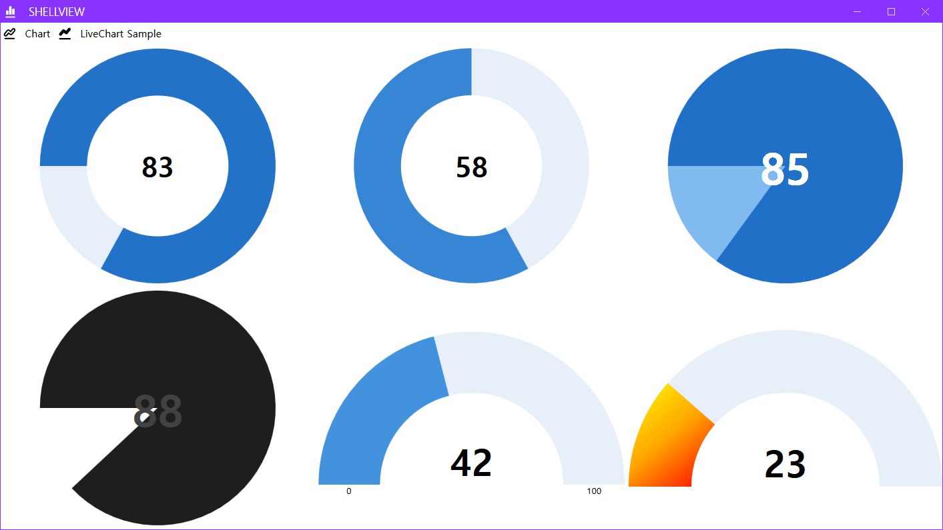
Live Chart (WPF)
Tutorial MVVM
GaugeCircleViewModel 작성
private void TickCallBack(object state)
{
var temp = new Random();
Value1 = temp.Next(10, 99);
Value2 = temp.Next(0, 100);
Value3 = temp.Next(10, 90);
Value4 = temp.Next(5, 100);
Value5 = temp.Next(11, 98);
Value6 = temp.Next(22, 30);
}

Slide 23
Live Chart (WPF)
Tutorial MVVM
PieChartViewModel 생성
PieChartView.xaml 생성
public void LoadPieChart()
{
ActivateItem(new PieChartViewModel());
}
<lvc:PieChart Series="{Binding SeriesCollection}"
LegendLocation="Right" InnerRadius="100" Margin="0 15">
<lvc:PieChart.ChartLegend>
<lvc:DefaultLegend BulletSize="20"/>
</lvc:PieChart.ChartLegend>
<lvc:PieChart.DataTooltip>
<lvc:DefaultTooltip BulletSize="20"/>
</lvc:PieChart.DataTooltip>
</lvc:PieChart>

Slide 24
Live Chart (WPF)
Tutorial MVVM
PieChartViewModel 작성
public SeriesCollection SeriesCollection { get; set; }
public PieChartViewModel() {
SeriesCollection = new SeriesCollection {
new PieSeries {
Title = "Chrome",
Values = new ChartValues<ObservableValue> { new ObservableValue(8) },
DataLabels = true
},
new PieSeries {
Title = "Mozilla",
Values = new ChartValues<ObservableValue> { new ObservableValue(6) },
DataLabels = true
},
new PieSeries {
Title = "Opera",
Values = new ChartValues<ObservableValue> { new ObservableValue(10) },
DataLabels = true
},
new PieSeries {
Title = "Explorer",
Values = new ChartValues<ObservableValue> { new ObservableValue(4) },
DataLabels = true
} }; }

Slide 25
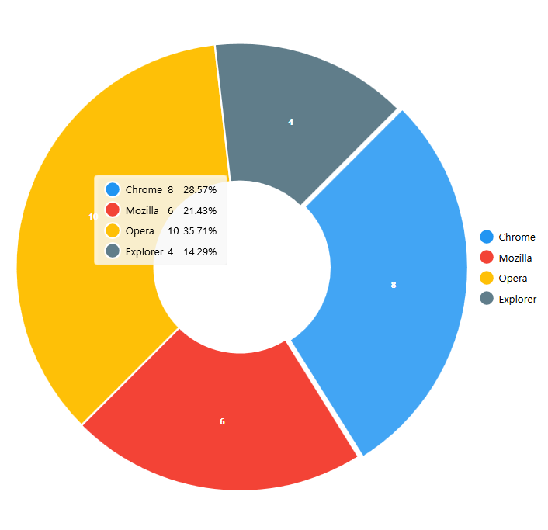
Live Chart (WPF)
Tutorial MVVM
실행 결과

Slide 26
DevExpress
상용 컴포넌트 시장

Slide 27
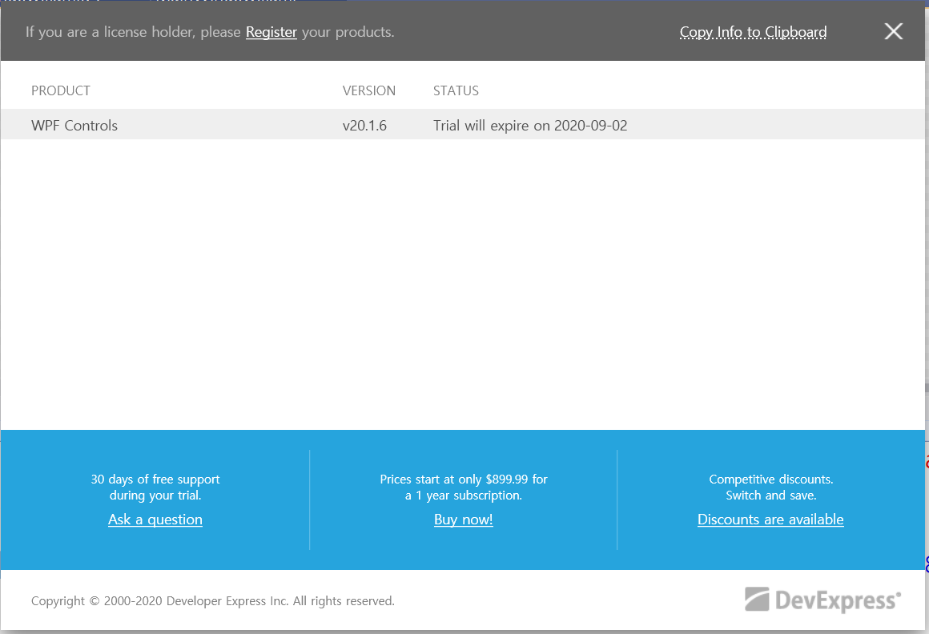
DevExpress
Tutorial
DevExpress 30일 Trial 설치 - WPF만 설치

Slide 28
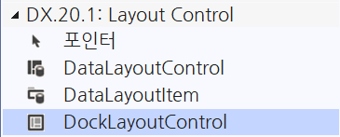
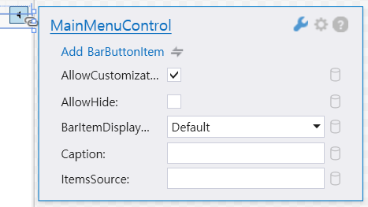
DevExpress
Tutorial
WPF 앱 프로젝트 생성
Xaml 디자이너 도구상자에서 DockLayoutControl 드래그
오른쪽 상단 플레이 버튼 클릭해서 내용 확인
Add BarButtonItem
<dxlc:DockLayoutControl>
<Grid dxlc:DockLayoutControl.Dock="Top">
<dxb:MainMenuControl />
</Grid>
</dxlc:DockLayoutControl>

Slide 29
수고 많으셨습니다
추가 문의사항이 있을 경우, 메일로 여쭤주시기 바랍니다.
personar95@naver.com

Slide 30
윈도우 탐색기
이벤트 코딩
TvFolder_AfterSelect 이벤트 핸들러
FileInfo info = new FileInfo(file);
// 이전 페이지 이어서…
ListViewItem item = new ListViewItem(new string[]
{
info.Name, info.Length.ToString(),
info.Extension, info.LastWriteTime.ToString()
});
LvFiles.Items.Add(item);
}
}
catch (Exception ex)
{
MessageBox.Show(ex.Message);
}

